Slide 1


Group Members
01
Asjad Ullah (UET-31)
FINAL YEAR PROJECT
NEWS MAVENS
02
Usama Shafique (UET-40)
Freelance Platform for Journalists
03
Rameen Naveed (UET-42)
Supervised By
Engr. Fahim Muhammad Khan

Slide 2

Contents
Introduction
Problem Statement
Aim and Objectives
Literature Review/Background Knowledge
Existing System
Methodology
Evaluation Parameters
References

Slide 3

Introduction
News Mavens will be the first platform for everyone to keep them self up to date about daily news reports.
Our platform will provide remote work for journalists as many big companies or media houses can hire them on remote basis work (small projects, contract basis).

Slide 4
Problem Statement
Job security is one of the most challenging aspects of being a journalist nowadays.
People nowadays rely on social media news that isn't authenticated and doesn't have a reliable source.
Also media houses can't find the right person because of the market gap.
Many News agency requires journalist for single project but they have to hire them as there isn’t a proper channel for hiring journalist for single project remotely or on- site

Slide 5
Aim
To facilitate journalists, viewer's and media houses to see/post updated jobs/news.
Objectives
To help journalist community to provide freelance remote work opportunities and reduce job insecurity.
To help media houses, new channels and online newspapers companies to find the best journalist they need.
Help to keep everyone up to date with daily news about news reports by providing an authentic and resourceful news

Slide 6
Literature Review
"In the phases of economic downturn, working journalists have always been affected by downsizing, termination, and layoff and cut in salaries as well as job- related issues which are heighten job related concerns in journalists working in the media industry. "[1]
Issues
Job insecurity issues
Salaries Issues
overburden on journalist and they work more than office working hours.

Slide 7
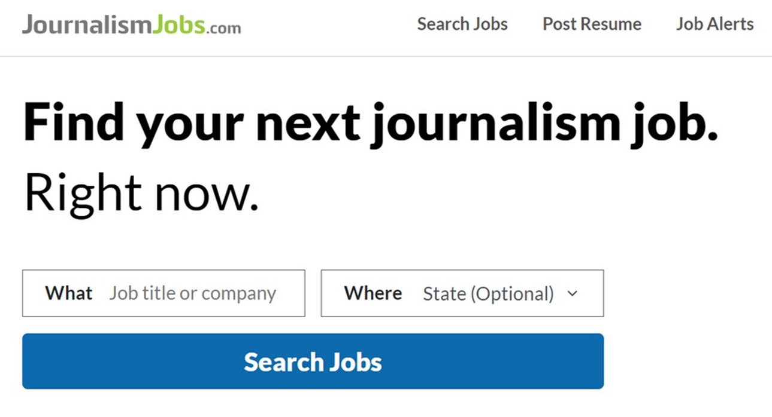
Existing System
1. Journalism Jobs.com
JournalismJobs.com is only job posting website with just “apply for” link doesn't have a suitable platform for journalist and new industry organization.
Limitations
Only job posting website with just "apply for" link doesn't have a suitable platform for journalist and News industry organizations
No communication between journalist and organizations.
resume displaying option, doesn't have portfolio feature for journalist to display their work and skills.

Slide 8
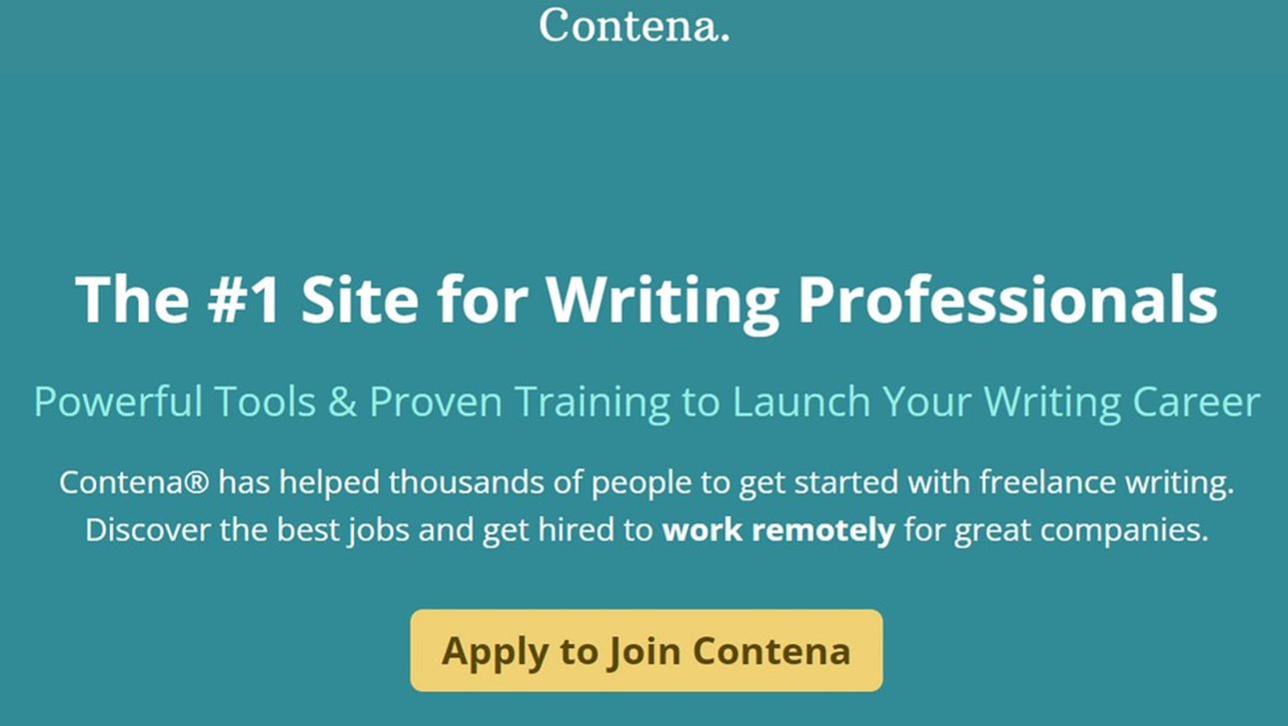
2. Contena
Contena is a premium freelance writing website that aims to be more than “just another job board.”
First, they have what they call their “writing job finder” that automatically collects the best freelance writing gigs from around the web.
Limitations
Only for those journalist who are writers.
Paid
limited to just one service that they provide to News industry which is writing

Slide 9
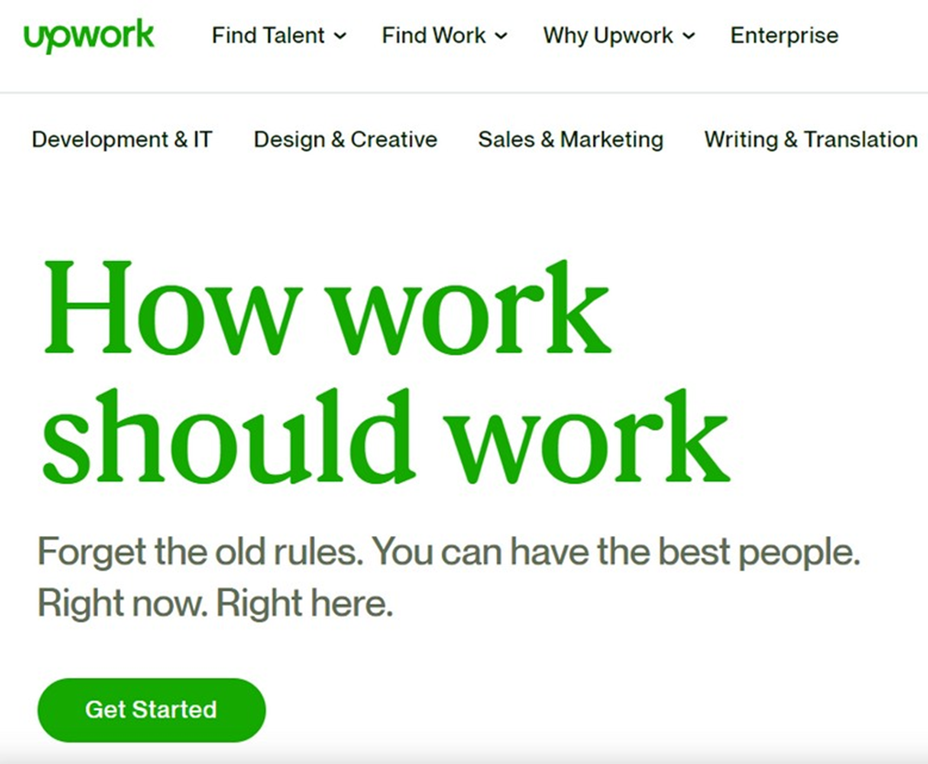
3. Up Work
Upwork is not specially for journalist and commonly use by writer.
While the marketplace features freelance jobs of all sorts, there are plenty of freelance writing jobs available-for blogging to resume writing, website copywriting to technical documentation
Limitations
Not Specifically for journalists
commonly used by writers
Highest fees for freelance writing sites

Slide 10
Proposed System
1. News Mavens:
The platform we offer will give journalists access to regular employment prospects in the form of long-term projects. Opportunities and lowering journalist job insecurity The audience will receive insightful daily news updates from News Mavens that they can trust.
Features And Add-ons:
Our platform allows journalists to work from anywhere.
Our platform enables media companies and news agencies to receive news reports from distant journalists in locations where they are unable to send staff members right away.
Our technology will enable viewers to get all types of news via a mobile app.

Slide 11
The table below is comparison between existing systems and our system.
Existing System | Remote | Specialized Platform | Daily Vast News Update
Contena | ✓ | X | X
JournalismJobs.com | ✓ | X | X
Upwork | X | X | X
News Mavens | ✓ | ✓ | ✓

Slide 12
Proposed Methodology
Agile Methodology:
We are using agile methodology because our project is open-ended. It will require changes on a daily or maybe weekly basis so for that reason we prefer agile methodology
We have concluded that XP agile framework is most suitable for our project from time perspective. Following are other main aspects of XP;
Cost effective
Simplicity
High visibility
Feedback

Slide 13
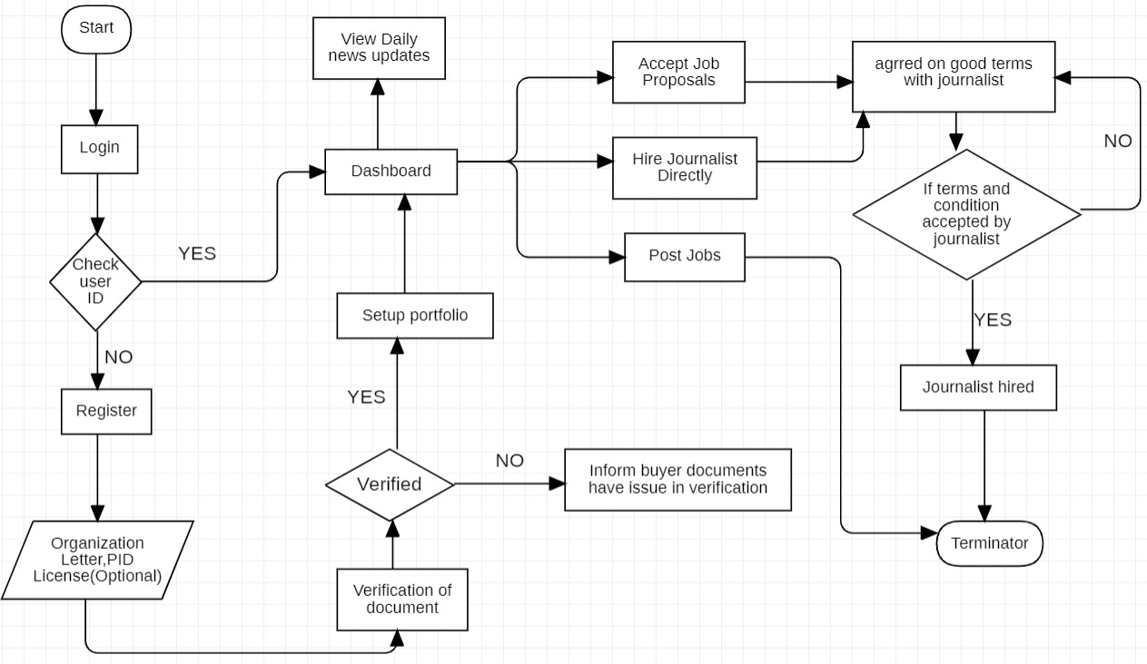
Flow Diagram
Buyer Flow diagram

Slide 14
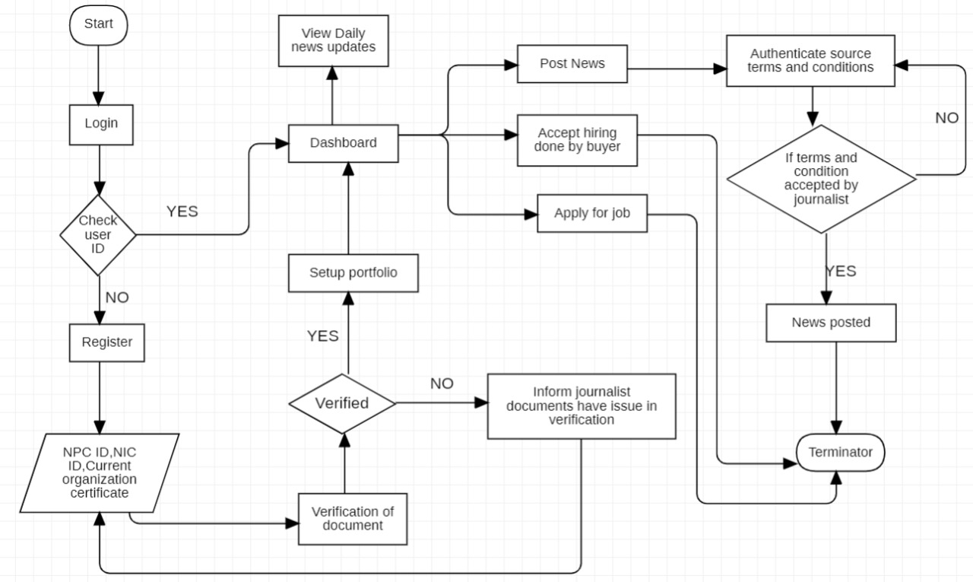
Journalist Flow diagram

Slide 15
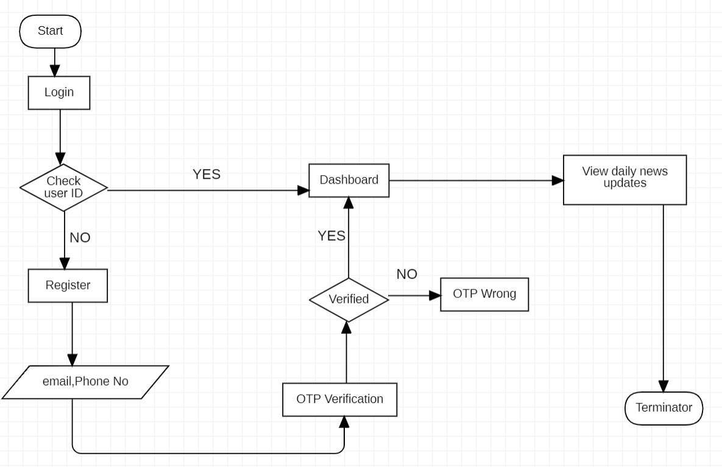
Viewer Flow diagram

Slide 16
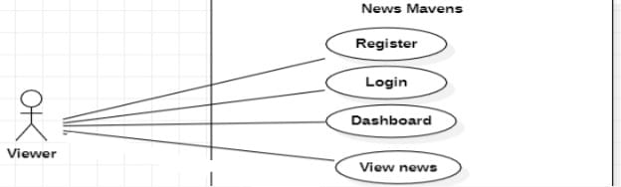
Use-case Diagrams:
use case diagram of viewer

Slide 17
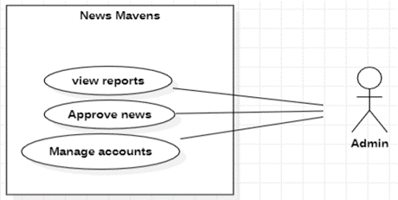
use case diagram of Admin

Slide 18
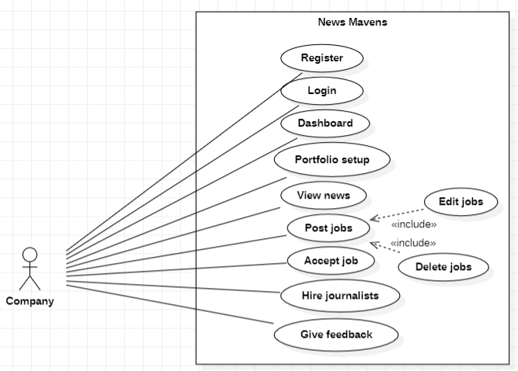
use case diagram of company

Slide 19
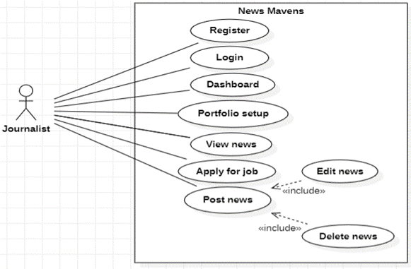
use case diagram of journalist

Slide 20
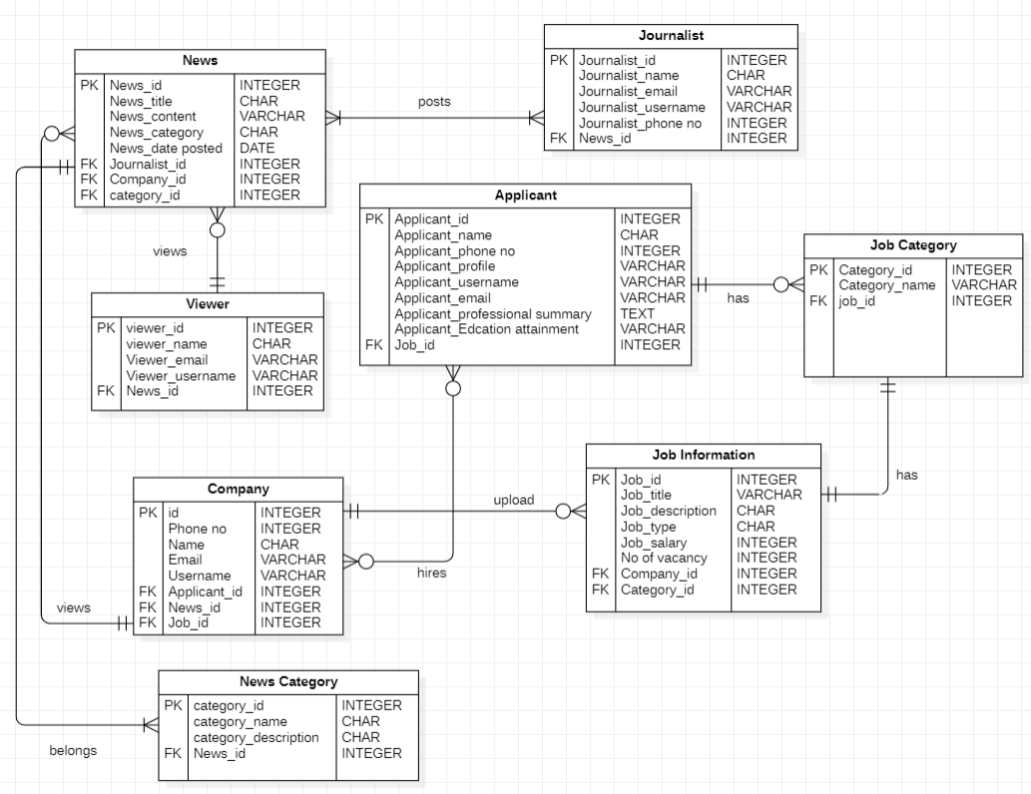
ER- Diagram:

Slide 21
Evaluation Parameters
Appium:
We use Appium to test our mobile applications before they are released to the public. This is done to see if mobile applications work well across different operating systems and mobile devices.
Web Load:
Web LOAD is load testing tool. We use this to check the performance of our system also check the stress of our web application. This web and mobile load testing and analysis tool is from Review Software.
Acunetix:
Acunetix is an automated web application security testing tool that audits our web applications by checking for vulnerabilities like SQL Injection, Cross site scripting and other exploitable vulnerabilities.

Slide 22
References
Westland, O. (2013). Mobile news: A review and model of journalism in an age of mobile media. Digital journalism, 1(1), 6-26.
Sotiropoulos, E., Vryzas, N., Vrysis, L., Avraam, E., & Dimoulas, C. (2019). Growing media skills and know-how in situ: Technology-enhanced practices and collaborative support in mobile news-reporting. Education Sciences, 9(3), 173.
Vandenbroucke, K., Baccarne, B., & Schuurman, D. (2014). Connecting with citizen journalists: an exploratory Living lab study on motivations for using mobile reporting applications. In Etmaal van de communicatiewetenschappen, Proceedings. Wageningen, The Netherlands.

Slide 23
Ashraf, A., Tayyib, M., Awais, M., & Ali, F. (2020). Effects of job insecurity on media professionals of Pakistan. Journal of Organizational Culture, Communications and Conflict, 24, 1-15.
Westland, O. (2013). Mobile news: A review and model of journalism in an age of mobile media. Digital journalism, 1(1), 6-26. 3.
Alcott, H., & Gentzkow, M. (2017). Social media and fake news in the 2016 election. Journal of economic perspectives, 31(2), 211-36.

Slide 24
Q & A

Slide 25
Thank You

